Slide 1
Gastrointestinal physiology

Slide 2
Unit 1

Slide 3
Gastrointestinal system
The gastrointestinal system is responsible for digestion and absorption of nutrients required for growth, energy, and body maintenance.
It consists of a long muscular tube known as the alimentary canal plus associated digestive glands.

Slide 4
Organ | Main Function
Mouth | Chewing (mastication), mixing food with saliva, beginning of starch digestion
Pharynx & Esophagus | Swallowing and transport of food to stomach
Stomach | Storage and mixing of food; begins protein digestion
Small Intestine (Duodenum, Jejunum, Ileum) | Major digestion and absorption of nutrients
Large Intestine (Colon) | Absorption of water & electrolytes, formation of feces
Rectum & Anus | Storage and expulsion of feces

Slide 5
Functions
1. Ingestion
Intake of food into the mouth
2. Digestion
Breakdown of food into smaller components
  Mechanical digestion → chewing & churning
  Chemical digestion → enzymes & acids
3. Absorption
Transfer of nutrients from intestine to blood/lymph:
  Carbohydrates → glucose
  Proteins → amino acids
  Fats → fatty acids & glycerol
  Vitamins, minerals & water also absorbed

Slide 6
Functions
4. Motility
Coordinated movement of food along the GI tract by peristalsis
Controlled by:
  Enteric nervous system
  ANS
  GI hormones
5. Secretion
GI tract & glands release enzymes, mucus, hormones, HCl, bile, etc.
6. Excretion
Removal of undigested waste as feces
7. Host Defense
GI immunity prevents entry of pathogens:
  Acidic environment of stomach
  Immunoglobulin A (IgA)
  Gut-associated lymphoid tissue (GALT)

Slide 7
Unit 2

Slide 8
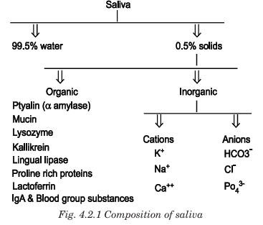

Slide 9
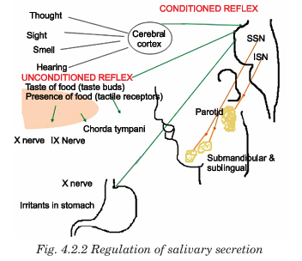

Slide 10
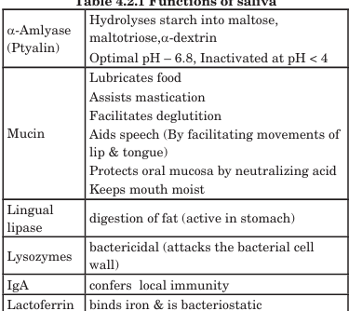
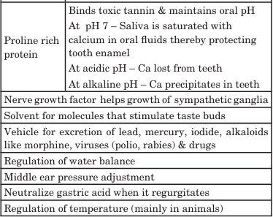

Slide 11
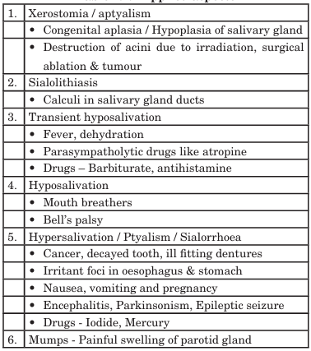
Applied aspect

Slide 12
Degluttion
Deglutition (swallowing) is the process of transporting food from the mouth to the stomach.
It involves voluntary and involuntary (reflex) actions that ensure safe movement of food without entering the respiratory tract.
Stage | Location | Nature
1. Oral stage | Mouth | Voluntary
2. Pharyngeal stage | Pharynx | Involuntary / Reflex
3. Esophageal stage | Esophagus | Involuntary / Reflex

Slide 13
Oral Stage (Voluntary Phase)
Food is chewed and mixed with saliva → bolus formation
Tip of tongue presses against hard palate
Tongue pushes bolus backward into pharynx
🔹 Ends when bolus reaches the oropharynx
🔹 Controlled voluntarily

Slide 14
Pharyngeal Stage (Involuntary Reflex Phase)
Bolus enters the pharynx → swallowing reflex triggered
Respiration is temporarily inhibited (to prevent choking)
Protective mechanisms to prevent entry into airway:
  Soft palate elevates → closes nasopharynx
  Epiglottis covers larynx → closes airway
  Vocal cords close
Bolus moves rapidly from pharynx to esophagus
⏳ Very fast stage (about 1 second)

Slide 15
Esophageal Stage (Involuntary Phase)
Bolus enters esophagus
Transport to stomach by peristaltic waves
  Primary peristalsis – normal wave triggered by swallowing
  Secondary peristalsis – if food remains in esophagus
Lower esophageal sphincter (LES) relaxes
→ Bolus enters stomach

Slide 16
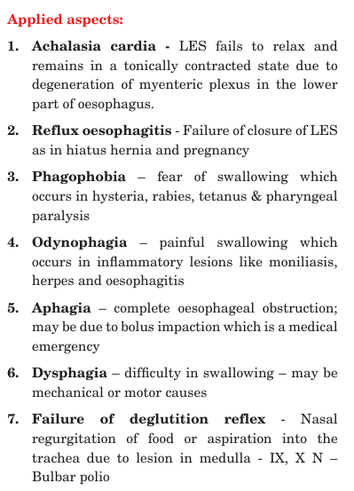

Slide 17
Unit 3

Slide 18
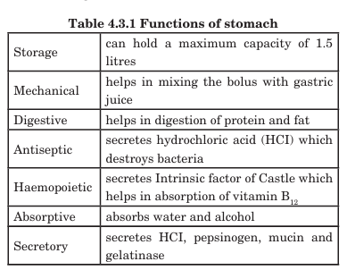

Slide 19
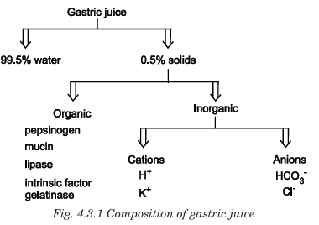

Slide 20
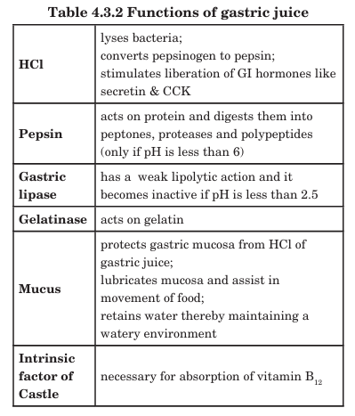

Slide 21
Cephalic Phase (Head Phase)
🔹 Initiated before food enters the stomach
🔹 Triggered by: sight, smell, taste, or thought of food
🔹 Mediated by the vagus nerve (parasympathetic) → stimulates gastric glands
Mechanism
Food stimulus → hypothalamus → medulla → vagus nerve → ACh release → gastric glands secrete:
HCl from parietal cells
Pepsinogen from chief cells
Mucus from mucous cells
📌 Accounts for ~20–30% of total gastric secretion

Slide 22
Gastric Phase
🔹 Begins when food enters the stomach
🔹 Main stimuli:
Distension of stomach
Peptides and amino acids in food
↓ Gastric acidity (rise in pH)
Mechanism
Neural: Local enteric reflexes + vagovagal reflexes stimulate secretion
Hormonal: G cells release Gastrin → stimulates parietal cells to produce HCl and enhances pepsinogen release
📌 Accounts for ~60–70% of gastric secretion → largest contributor

Slide 23
Intestinal Phase
🔹 Begins when chyme enters duodenum
Inhibitory mechanisms (major portion)
Secretin
Cholecystokinin (CCK)
Gastric inhibitory peptide (GIP)
Enterogastric reflex
These inhibit:
Gastric acid secretion
Gastric motility
📌 Prevents over-filling of duodenum

Slide 24
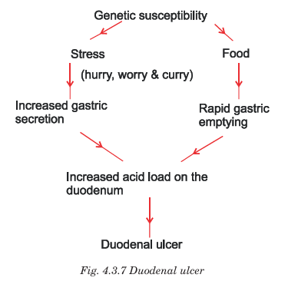
Applied aspects

Slide 25
Unit 4

Slide 26
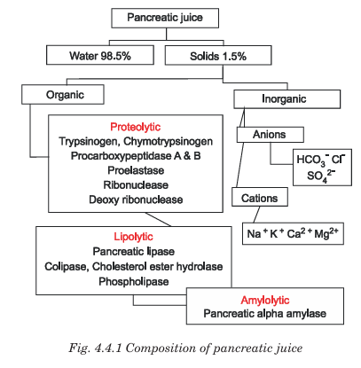

Slide 27
Functions of pancreatic juices
Component / Enzyme | Type | Specific Function
Pancreatic Amylase | Carbohydrate-digesting enzyme | Converts starch → maltose, dextrins
Trypsinogen → Trypsin | Protein-digesting enzyme | Breaks proteins into polypeptides; activates other proteases
Chymotrypsinogen → Chymotrypsin | Protein-digesting enzyme | Further digestion of polypeptides
Procarboxypeptidase → Carboxypeptidase | Protein-digesting enzyme | Releases terminal amino acids from peptides
Proelastase → Elastase | Protein-digesting enzyme | Digests elastin and other proteins
Pancreatic Lipase | Fat-digesting enzyme | Converts triglycerides → monoglycerides + fatty acids
Phospholipase A₂ | Fat-digesting enzyme | Digests phospholipids
Cholesterol Esterase | Fat-digesting enzyme | Breaks cholesterol esters
Ribonuclease (RNase) | Nucleic acid enzyme | Digests RNA → nucleotides
Deoxyribonuclease (DNase) | Nucleic acid enzyme | Digests DNA → nucleotides
Sodium Bicarbonate (HCO₃⁻) | Alkaline secretion | Neutralizes gastric acid; maintains pH 7–8 for enzyme activity
Water + Electrolytes | Fluid component | Provide medium for enzyme action and transport of chyme

Slide 28
Applied aspects
Disorder | Effect
Pancreatitis | ↓ secretion of enzymes → malabsorption
Cystic fibrosis | Thick secretion blocks ducts → steatorrhea (fatty stool)
Lack of lipase | Major fat malabsorption → weight loss

Slide 29
Unit 5

Slide 30
Functions of liver
Category | Functions
Metabolic Functions | • Carbohydrate metabolism (glycogenesis, glycogenolysis, gluconeogenesis) • Fat metabolism (β-oxidation of fatty acids, synthesis of cholesterol, lipoproteins, phospholipids) • Protein metabolism (deamination of amino acids, urea formation, synthesis of plasma proteins)
Synthetic Functions | • Synthesis of plasma proteins: albumin, globulins, fibrinogen, prothrombin • Synthesis of bile salts and bile pigments • Synthesis of clotting factors (II, V, VII, IX, X)
Storage Functions | • Stores glycogen • Fat-soluble vitamins A, D, E, K • Vitamin B12 • Iron and copper
Detoxification / Excretory Functions | • Detoxifies drugs, alcohol, hormones, and toxins • Converts ammonia → urea • Excretes bilirubin and cholesterol through bile
Immune Functions | • Contains Kupffer cells → phagocytosis of bacteria and old RBCs • Helps in antigen clearance
Hematological Functions | • RBC production in fetus • Breakdown of hemoglobin • Synthesis of clotting and anticoagulant proteins
Endocrine / Hormonal Functions | • Metabolizes hormones (insulin, glucagon, steroid hormones) • Produces somatomedins (IGF-1)
Water & Mineral Balance | • Helps maintain osmotic pressure via albumin • Helps regulate blood volume and electrolytes
Thermoregulation | • Generates heat due to high metabolic activity

Slide 31
Compostion of bile
Category | Components | Notes / Functions
Water (Major Component) | ~97–98% | Medium for transport
Bile Salts | Sodium glycocholate, sodium taurocholate | Important for emulsification and absorption of fats
Bile Pigments | Bilirubin, biliverdin | End products of hemoglobin breakdown; excretory function
Phospholipids | Mainly Lecithin | Assist in fat digestion; prevent precipitation of cholesterol
Cholesterol | Free cholesterol | Excreted in bile (only route of elimination)
Electrolytes | Na⁺, K⁺, Ca²⁺, Cl⁻, HCO₃⁻ | Produce alkaline pH
Proteins & Mucus | Small quantity | Protective and lubricating action
Trace Substances | Heavy metals, xenobiotics, drugs | Excretory function

Slide 32
Functions of bile
Category | Functions of Bile | Key Notes
Digestion of Fats | • Emulsification of fats | Breaks large fat globules → tiny micelles to increase surface area
 | • Activation of lipase | Provides optimal pH and conditions for pancreatic lipase
Absorption of Fats | • Helps absorption of fatty acids, monoglycerides | Forms micelles for transport to intestinal mucosa
 | • Necessary for absorption of fat-soluble vitamins A, D, E, K | Without bile → steatorrhea + vitamin deficiency
Excretory Role | • Removes bilirubin (waste product of hemoglobin) | Gives bile its yellow color
 | • Excretes cholesterol, drugs, toxins & heavy metals | Bile is the major route for cholesterol excretion
Neutralization Function | • Alkaline pH (7.6 – 8.6) neutralizes gastric acid | Protects intestinal mucosa and provides suitable pH for enzymes
Antibacterial / Immune Function | • Bile salts have bacteriostatic effect | Prevents growth of bacteria in small intestine
Laxative Function | • Stimulates intestinal motility | Helps prevent constipation

Slide 33
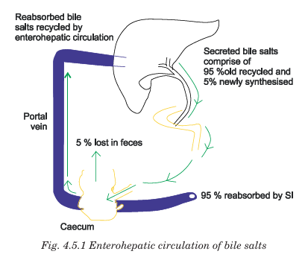

Slide 34
Applied aspect
Jaundice is the yellow appearance of skin, sclera and mucous membrane due to accumulation of free or conjugated bilirubin in the blood and is detectable when total plasma bilirubin >2mg/dl. Jaundice can occur due to excessive production of bilirubin, decreased hepatocyte uptake, impaired conjugation, decreased hepatocyte excretion of bilirubin glucuronides or impaired bile flow due to obstruction of bile duct. Pre hepatic (hemolytic) jaundice is due to excess production of bilirubin due to increased hemolysis of RBCs and is manifested by increased serum unconjugated bilirubin. Hepatic (Hepatocellular) jaundice is due to infections (bacterial or viral) or toxins (alcohol). In this condition, there is decreased uptake of bilirubin into hepatic cells, disturbed intracellular protein binding or conjugation, disturbed secretion of conjugated bilirubin into bile canaliculi and increased serum levels of both conjugated and unconjugated bilirubin. Post hepatic (obstructive) jaundice is due to bile duct obstruction which may be due to intra hepatic cause as in congenital biliary atresia or extrahepatic cause as in gallstones or tumor and is manifested by increased serum conjugated bilirubin. Decreased bile secretion can occur in liver diseases such as hepatitis or cirrhosis and gallbladder diseases such as gallstones

Slide 35
Succus entricus
Succus entericus (also called intestinal juice) is a alkaline digestive fluid secreted by the glands of the small intestine, especially the crypts of Lieberkühn.
📌 Daily secretion: ~1–2 liters
📌 pH: 7.5 – 8.0
📌 Consistency: Watery, alkaline fluid
Component | Examples / Details | Function
Water | Major component | Solvent and transport medium
Mucus | Goblet cells | Lubrication & protection of mucosa
Electrolytes | Na⁺, K⁺, HCO₃⁻, Cl⁻ | Maintain alkaline pH
Digestive Enzymes | Disaccharidases — maltase, sucrase, lactase | Carbohydrate digestion
 | Intestinal lipase | Fat digestion
 | Peptidases — aminopeptidase, dipeptidase, tripeptidase | Protein digestion
 | Enterokinase (enteropeptidase) | Activates trypsinogen → trypsin
Hormones (minor) | Secretin, CCK, GIP (from mucosa) | Regulate digestion

Slide 36
Applied aspects
Duodenal ulcer occurs due to impaired secretion of mucus by Brunner’s glands and reduced bicarbonate secretion by epithelial cells and Brunner’s glands. Cholera, E.coli, Clostridium and Shigella toxin can affect the small intestine leading to diarrhea. Lactose intolerance due to lactase deficiency leads to milk intolerance, diarrhea, bloating and flatulence. Malabsorption syndrome is an autoimmune disease which leads to deficient absorption of amino acids, carbohydrates, fat and fat soluble vitamins.

Slide 37
Func of large intestine
Category | Functions | Notes / Importance
Absorptive Function | Absorption of water and electrolytes (Na⁺, Cl⁻) | Converts liquid chyme → semisolid feces
 | Absorption of vitamins (B₁₂, biotin, vitamin K) | Produced by intestinal bacteria
Digestive Function (Limited) | Bacterial fermentation of undigested carbohydrates | Produces short-chain fatty acids (SCFA)
Synthetic Function | Intestinal bacteria synthesize vitamin K and certain B vitamins | Important for blood clotting & metabolism
Storage Function | Temporary storage of feces in rectum | Allows controlled defecation
Motor Function | Mass peristalsis and segmental movements | Helps propulsion of feces
Protective Function | Mucus secretion | Lubricates feces and protects mucosa
Immune Function | Gut-associated lymphoid tissue (GALT) | Defense against pathogens
Gas Production (Flatus) | Bacterial action produces gases such as CO₂, CH₄, H₂ | Physiological by-product of colonic bacteria

Slide 38
Unit 6

Slide 39
Motility of gut
Gastric motility
Small intestine motility
Large intestine motility

Slide 40
Gastric motility
Phase | Description / Major Events | Purpose
1. Receptive Relaxation | Relaxation of fundus and upper body when food enters stomach (via vagovagal reflex) | Allows storage of food without increase in pressure
2. Mixing / Churning Contractions | Strong peristaltic waves in antrum grind food and mix with gastric juice → formation of chyme | Mechanical & chemical digestion
3. Gastric Emptying | Peristaltic contractions push chyme through pylorus to duodenum | Regulated release of chyme to small intestine

Slide 41
movements of small intestine
Type of Movement | Description | Purpose
1. Segmental Contractions (Mixing movements) | Rhythmic contraction of circular muscles forming segments | Mixes chyme with enzymes & brings nutrients in contact with mucosa for absorption
2. Peristaltic Movements (Propulsive movements) | Successive waves of contraction pushing chyme forward | Propel chyme toward ileocecal valve
3. Pendular Movements | To-and-fro swinging of small intestine due to longitudinal muscle contraction | Improves mixing & exposure to mucosal surface
4. Tonic Contractions | Sustained contractions of isolated small segments | Slow chyme movement; allows prolonged absorption
5. Migrating Motor Complex (MMC) | Strong peristaltic waves during fasting at 90–120 min intervals | Clears residual food & bacteria (“intestinal housekeeper”)

Slide 42
movements of large intestine
Movement Type | Description | Function
1. Haustral Contractions (Segmental movements) | Localized rhythmic contractions of circular muscle forming haustra (sac-like bulges) | Mixing of chyme & absorption of water and electrolytes
2. Peristaltic Movements | Weak peristaltic waves that slowly push contents forward | Slow propulsion of fecal material
3. Anti-peristaltic Movements | Reverse peristalsis (mainly in proximal colon) | Delays passage of chyme to allow maximum absorption
4. Mass Peristalsis / Mass Movements | Powerful, long peristaltic waves moving large volumes toward rectum (few times/day) | Drives feces into rectum → initiates defecation reflex
5. Tonic Contractions | Sustained muscle contractions in some regions (especially sphincters) | Maintains compartmentalization & prevents premature emptying

Slide 43
defecation reflex
Step | Process
1. Filling of rectum | Feces enter the rectum due to mass peristalsis of colon
2. Stretch receptors activated | Distension of rectal wall → stimulates stretch receptors
3. Afferent impulses to spinal cord | Sensory signals travel to sacral spinal segments (S2–S4)
4. Parasympathetic efferents activated | Pelvic nerves send signals to rectum and internal anal sphincter
5. Contraction and relaxation | Rectum contracts; internal anal sphincter relaxes
6. Conscious control | External anal sphincter (skeletal muscle) voluntarily relaxed → defecation occurs
If not convenient to defecate | External anal sphincter contracts voluntarily → reflex temporarily inhibited
Defecation reflex is a spinal reflex that controls the elimination of feces from the rectum through the anus when the rectum becomes filled.
It involves coordinated contraction of smooth muscles & relaxation of sphincters.

Slide 44
Applied aspect
Adynamic ileus is reflex inhibition of movement of intestines after surgery due to trauma to peritoneum or intestines. Intestinal obstruction can occur due to mechanical obstruction leading to distension of the proximal segment which may occlude the blood vessels causing local ischemia. Peristaltic rush is powerful peristaltic contraction which occurs due to excessive irritation as in diarrhea. Hirschsprung disease is congenital absence of ganglion cells (aganglionic megacolon) which occurs in children who will defecate once in three weeks.

Slide 45
Unit 7

Slide 46
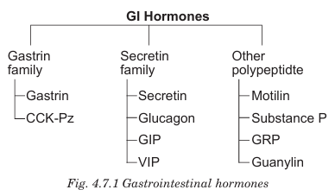
Gi hormones

Slide 47
Hormone | Site of Secretion | Primary Stimulus | Main Actions / Functions
Gastrin | G cells of stomach (antrum) | Presence of peptides, amino acids; stomach distension; vagal stimulation | ↑ Gastric acid (HCl) secretion, ↑ gastric motility, ↑ growth of gastric mucosa
Secretin | S cells of duodenum | Acidic chyme (↓ pH) entering duodenum | ↑ Bicarbonate secretion from pancreas, ↓ gastric acid secretion, ↓ gastric motility
Cholecystokinin (CCK) | I cells of duodenum & jejunum | Fatty acids & amino acids | Contracts gallbladder, relaxes sphincter of Oddi, ↑ pancreatic enzyme secretion, ↓ gastric emptying
Gastric Inhibitory Peptide / Glucose-dependent insulinotropic peptide (GIP / GLP) | K cells of duodenum & jejunum | Fatty acids, glucose | ↓ Gastric acid secretion, ↓ gastric motility, ↑ insulin secretion
Motilin | M cells of duodenum & jejunum | Fasting state (every 90 min) | Increases GI motility; initiates migrating motor complex (MMC)
Vasoactive Intestinal Peptide (VIP) | Enteric neurons | Distension & vagal stimulation | Relaxes smooth muscle; ↑ intestinal secretion; dilates blood vessels
Somatostatin | D cells of stomach & pancreas | Acid | Universal inhibitor – inhibits gastrin, secretin, CCK, insulin, glucagon & gastric acid
Enteroglucagon | Intestine | Nutrients in gut | Slows GI motility → allows more absorption
Peptide YY (PYY) | Ileum & colon | Fatty meal | ↓ Gastric emptying, ↓ intestinal motility (ileal brake)

Slide 48
Applied aspects
Prolonged excess secretion of acid occurs in Zollinger Ellison syndrome which is seen in gastrinomas. These gastrin secreting tumours occur in stomach, duodenum and pancreas. Secretin / CCK – PZ test is used to assess pancreatic exocrine function. The volume, pH, amylase and bicarbonate content of duodenal secretion are assessed before and after administration of Secretin / CCK – PZ. Abnormal results occur in chronic pancreatitis, cystic fibrosis and pancreatic cancer. Somatostatinoma is a nano neuro endocrine tumour which secretes somatostatin

